Slide 1



Petroleum University of Technology National Iranian Drilling Co.
(PUT) (NIDC)
Acoustic Borehole Imaging
(Principles and Applications)
Zohrab Dastkhan Dr. M. Ghassem Al-Askari
Oct 5th, 2005

Slide 2
Why borehole imaging?
Exploration and production practices can be improved if it is possible to “look” at certain borehole conditions, by any form of direct or indirect imaging.
It is necessary to have a visual description of fractures, vugs, breakouts, borehole shape, casing & tubing conditions, or even conditions behind the casing.

Slide 3
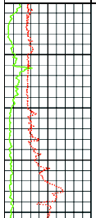
Comparison …
Petrophysical Well Logs
Well Imaging Logs
Indirect evaluation of physical properties
Direct visualization of borehole condition

Slide 4
Borehole Imaging Devices
Optic Devices
Stationary images
Holes with clear visibility
Clear water, air, or gas in hole
Microresistivity
Devices
4 or 6 arm devices
Water-based mud in hole
Limited borehole coverage (max 80%)
Acoustic Devices
Oil- based as well as water-based muds
Full bore coverage (360º)
Detailed borehole shape (Acoustic caliper)
Applicable in both open and cased holes

Slide 5
Optic Devices:
Downhole Camera, Fluorescent
Microresistivity
Devices:
FMS, FMI, ARI, RAB, OBMI, EMI, STAR
Acoustic Devices:
BHTV, CBIL, CAST, UBI, SATR

Slide 6
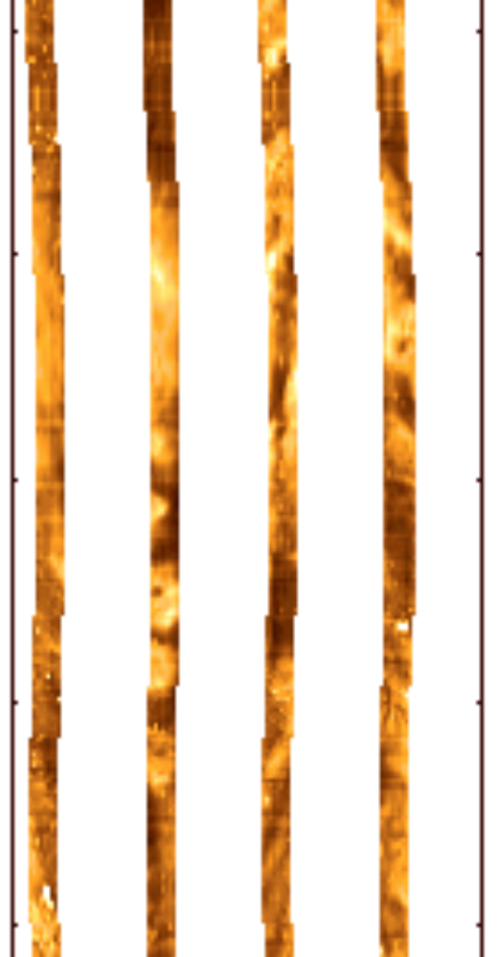
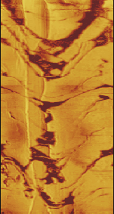
Examples …
Microresistivity image
Acoustic / Ultrasonic image

Slide 7
History of Acoustic Borehole Imaging
Borehole televiewer (BHTV) was invented by Mobil in 1969 (Zemanek et al.). In late 1970’s, Amoco began research to improve imaging capabilities of BHTV.
BHTV takes an oriented acoustic picture of the inside of the well bore in the form of a continuous log. BHTV was limited to fracture detection and casing inspection, but later enhancements enabled it to function as a high-resolution dipmeter and borehole geometry tool.

Slide 8
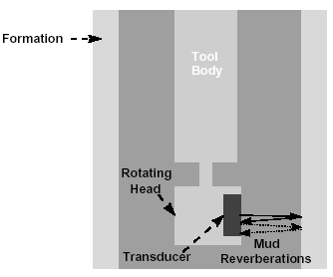
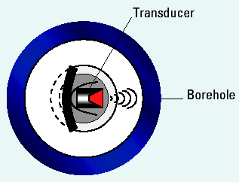
Theory of Operation
High frequency sound (250 kHz to 2 MHz) is directed toward borehole wall from a piezoelectric transducer. A portion of sound is reflected back. The transducer which also acts as a receiver, converts the reflected pulses into electrical signals for producing televiewer log.

Slide 9
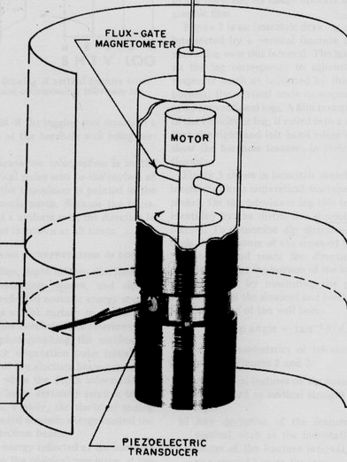
Main measurements:
Reflected amplitude
Interval transit time
Hole azimuth
Schematic layout of televiewer.

Slide 10
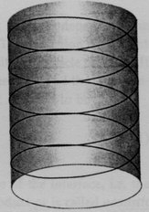
The combination of transducer rotation with the vertical movement of logging tool results in a continuous spiral of borehole wall being scanned.
Vertical resolution
Azimuthal resolution

Slide 11
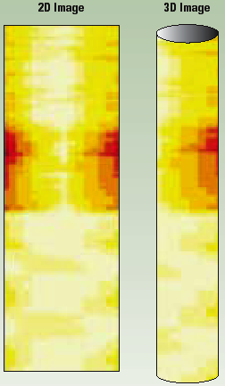
The resulting log is a representation of well bore wall as if it were split vertically along north and laid out flat.
Borehole cross sections and radius profile can be also reproduced from transit time data.

Slide 12
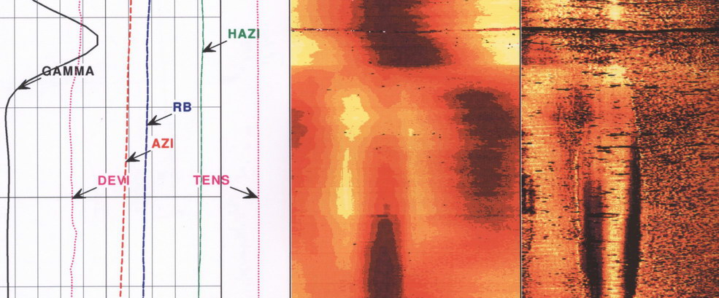
Log Presentation
Well deviation
Hole azimuth
Gamma ray
Borehole radius
Reflected amplitude image
N E S W N E S W N

Slide 13
New generations of BHTV are modified to ensure reliability and increase performance in denser mud systems with minimum sacrifice of resolution.
Old tools New tools
Frequency: 2 MHz 250-500 kHz
Azimuthal sampling: 600 per rev. 100-250 per rev.
Ultrasonic imagers today in use:
Schlumberger: Ultrasonic Borehole Imager (UBI)
Halliburton: Circumferential Acoustic Scanning Tool (CAST)
Western-Atlas: Circumferential Borehole Imaging tool (CBIL)

Slide 14
Ultrasonic imaging tools provided by three service companies
 | UBI | CBIL | CAST
Scanner assembly | Rotating heads (with 4 sub sizes) | Rotating sensor (in oil-filled chamber) | Rotating heads (interchangeable)
Transducer frequency | Focused 250, 500 kHz | Focused (two) 250 kHz | Focused 280, 450 kHz
Scan rate | 7.5 RPS | 6 RPS | 6-18 RPS
Samples/scan | 180 | 125 - 250 | 100 - 200
Scan/foot | 12 - 72 | 16 - 64 | 40 - 120
Min. hole size | 5.5 in | 5 in | 5 in

Slide 15
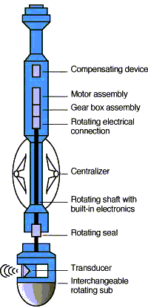
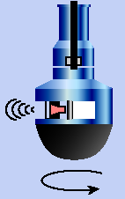
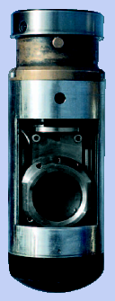
Sketch of UBI tool and its rotating assembly (sub)

Slide 16
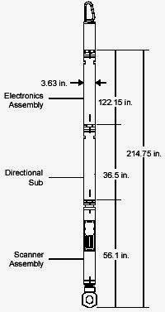
Specifications of CAST
The Halliburton CAST-V may be used in both open hole (imaging mode) and cased hole (cement mapping).
Electronic assembly
High-frequency ultrasonic transducer
Second transducer and mud cell
Directional sub assembly
Telemetry and data transmission system
Directional Sub
Scanner Assembly
Rotating Head

Slide 17
CAST-V Imaging mode Cased-hole mode
Sensor Type: Firing Rate (shots/scan): Vertical Scan Rate: Telemetry System: Principle: Azimuthal Sampling: Vertical Sampling: Logging Speed: Primary Curves: Secondary Curves: Min. Diameter Hole: Max. Diameter Hole: | Piezoelectric on rotating head 200 40 scans/ft at 21 ft/min DITS Ultrasonic Pulse Echo 1.8° 0.2 in. 21 ft/min Reflected Amplitude and Travel Time Radius, Azimuth, Relative Bearing, Deviation, and Fluid Transit Time 4.5 in. (11.4 cm) 12.50 in. (31.75 cm) | Piezoelectric on rotating head 100 4 scans/ft at 30 ft/min DITS Ultrasonic Pulse Echo 3.6° 6.0, 3.0, or 1.0 in. 60, 30, or 10 ft/min Reflected Amplitude, Radius, Acoustic Impedance, and Casing Wall Thickness Deviation, Relative Bearing, Compressive Strength, Fluid Transit Time, and Mud Impedance 5.5 in. (12.7 cm) 13.375 in. (33.97 cm)

Slide 18
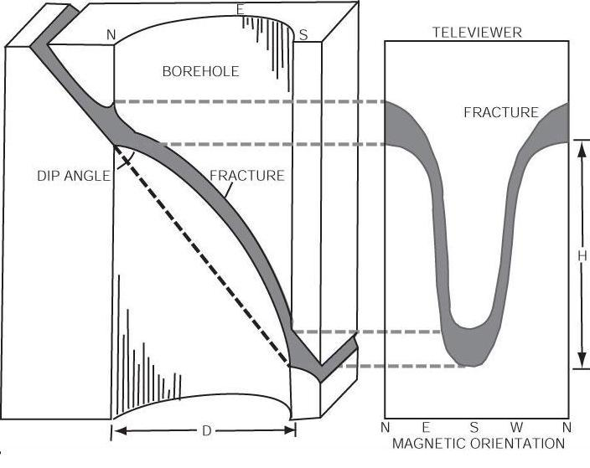
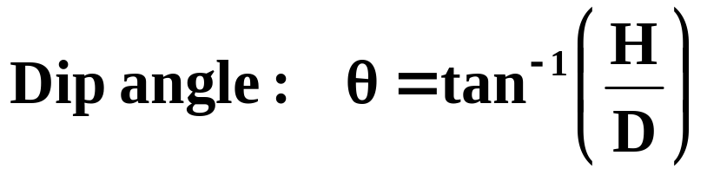
Dip direction: azimuth of the minimum of the sinusoid
s

Slide 19
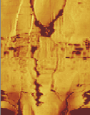
Principles of Interpretation
All vertical features on the borehole wall are reproduced as vertical straight lines on the log.
Any deviation of features from the vertical is reflected as curved line on the log.

Slide 20
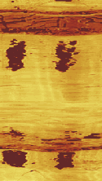
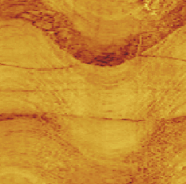
When any feature which crosses the well bore is surveyed, each half of its representation on the televiewer log is the mirror image of the other half.

Slide 21
Dip direction: azimuth of the minimum of the sinusoid
D
H
S
N E S W N

Slide 22
Applications of image interpretation
Open hole
Cased hole
Fracture identification and analysis
Cement evaluation
Casing inspection
Hole shape analysis, breakouts, slippage, ovalization
Corrosion monitoring
Perforations monitoring
Bedding analysis
Other …
Other …

Slide 23

Open hole applications:
Fracture identification and analysis
Natural fractures
Induced fractures

Slide 24
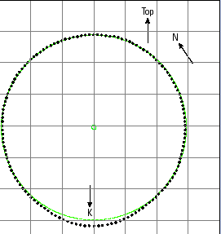

Open hole applications:
Hole shape analysis
Keyhole wear

Slide 25
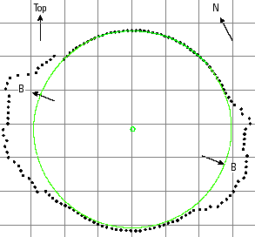
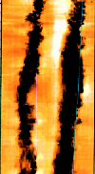
Open hole applications:
Breakout on opposite sides
Hole shape analysis

Slide 26

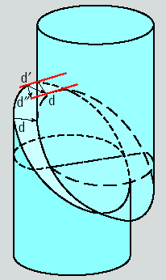


Slippage and shear sliding
Along strike of an existing fracture
(left-hand shear)
Along dip of an existing fracture
(normal movement)
Along dip of an existing fracture
(reverse movement)

Slide 27
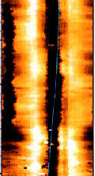
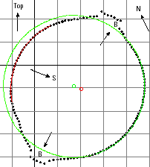
Open hole applications:
Hole shape analysis
Slippage and shear sliding

Slide 28
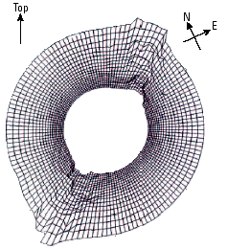
Open hole applications:
3-D borehole shape
Hole shape analysis

Slide 29
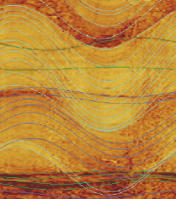
Open hole applications:
Bedding analysis
Lithological changes
Reservoir zonation
Sedimentology interpretation

Slide 30
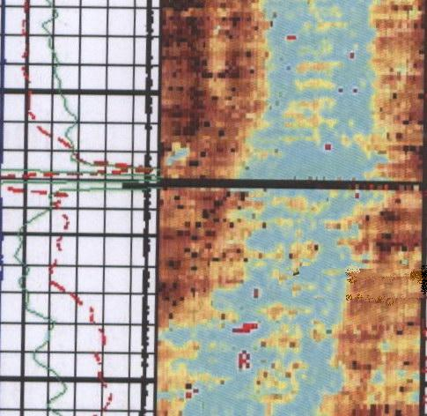
Cased-hole applications:
Cement evaluation
Cement
Cement bond to casing
Cement bond to formation
Microchannels in cement
Microdebondings
Channel

Slide 31
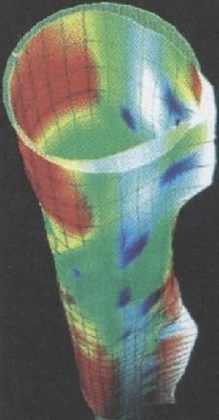
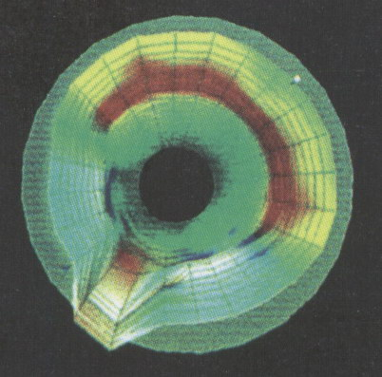
Cased-hole applications:
Casing inspection
Casing thickness
Internal and external radii of
casing and tubing
Corrosion pits on casing wall
Mechanical problems

Slide 32
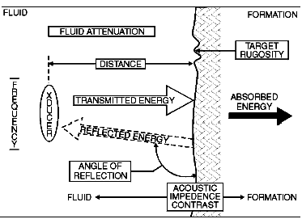
Environmental conditions affecting amplitude

Slide 33
Optimum conditions for acoustic imaging
Borehole rugosity: The smoother, the better.
Mud in hole: Water is better than oil.
Mud weight: The lighter, the better.
Frequency: Higher frequencies give better
resolution, but weaker reflected amplitude.
Logging speed: Slower speeds give better vertical resolution.
Processing: Eccentering corrections, image enhancement, and
noise filtering improve images.

Slide 34
Conclusions
The most detailed information about well bore geometry, radius and shape can be obtained by ultrasonic imaging.
Ultrasonic borehole images contain useful structural information, such as breakouts and borehole elongations on transit time images, and faults and fractures on amplitude images.
Their bedding information is not as rich as microresistivity images, but can be sufficient if proper acquisition procedures are followed.
Their advantage is that they can be run in oil-based muds as well as water-based muds.

Slide 35

Thank you.

